Slide 1

A Language-independent Model for Introducing a New Semantic Relation Between Adjectives and Nouns in a WordNet
Mladenović Miljana, Mitrović Jelena, Krstev Cvetana
University of Belgrade
Serbia

Slide 2
Overview
Language-independent process of creating a new semantic relation between adjectives and nouns in wordnets – Serbian WordNet example
Semi-automatic method for adding a new cross-POS semantic relation
Crowdsourced evaluation

Slide 3
Motivation
New semantic relations improve the detection of ﬁgurative language and sentiment analysis (SA)
Connection with other semantic resources for Serbian (e.g. Ontology of Rhetorical Figures)

Slide 4
Motivation
Simile – the rhetorical figure of comparison inspiration for the new relation
Simile have a high frequency of occurrence in a natural language
<Adjective> as <Noun> structure

Slide 5
Semantic relations in WN
Between noun synsets: synonymy, antonymy, hyponymy/hyperonymy and meronymy/holonymy
Between verb synsets: troponymy, implication and casuality
Cross-POS – “morphosemantic” links: observe (verb), observant (adjective) observation, observatory (nouns)
For noun-verb pairs, the semantic role of the noun with respect to the verb has been specified: {sleeper, sleeping_car} is the LOCATION for {sleep} and {painter}is the AGENT of {paint}, while {painting, picture} is its RESULT

Slide 6
Serbian WordNet
Developed in the scope of BalkaNet (2001-2004)
Further development dependent on volunteer work
New tools built instead of VisDic *Described in our GWC 2014 paper titled “Developing and Maintaining a WordNet: Procedures and Tools”
Better overall control and accuracy

Slide 7
Serbian WordNet

Slide 8
Serbian WordNet
Currently around 23 000 synsets
New automation method under construction to allow for faster adding of new synsets without losing quality and control

Slide 9
The Process of adding the New Cross-POS relation
Extract Similes (Adjective-Noun constructs) from the Corpus of Contemporary Serbian Language (5952 extracted)
If adjectives were not descriptive, nouns were proper names, or acronyms – constructs excluded
1059 concordances used to automatically determine relevant Adjective-Noun constructs
According to the algorithm which allows for adding new relations specificOf /specifiedBy to WN between Adjectives and Nouns with semantic relations pertinent to the Simile rhetorical figure, candidates for expansion.

Slide 10
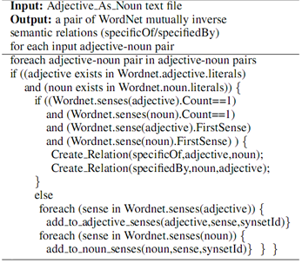

Slide 11
Results
372 candidates that can be connected by the relation SpecificOf/SpecifiedBy
Vredan kao pčela “Busy as a Bee”;
Cunning as a fox “Lukav kao lisica”
{busy} SpecificOf {bee}
{bee} SpecifiedBy{busy}
For the rest of the possible ADJ-NOUN pairs, a web page in the SWNE2 application (used for all semantic resources for Serbian) for semi-automatic input.

Slide 12
Evaluation
From the list described in Step 1, constructs marked relevant by a linguistic expert were added to Google Forms
“Find Adjective-Noun constructs used in everyday language”
Advertised via Facebook
5 days
“Yes” or “No” answers
Letting us know if they use a certain construct or not. Table shows the number of questions and participants per each form.

Slide 13
Distribution of questions and participants per form
Google form | Number of questions per form | Participants per form
1 | 30 | 46
2 | 42 | 138
3 | 41 | 150
4 | 41 | 100
Total | 154 | 434

Slide 14
Crowdsourcing project
1st day – some attention in the beginning, a lot by the end of the day
Shares, Likes, Comments
Post privacy set to Public
Google form kept at the same URL to keep the momentum of the post (good decision)

Slide 15
Inter-annotator agreement
1) If there is no substantial difference between arithmetic means of the participants’ answers according to a paired t-test, go to step 2.
2) 7 subsets of questions and answers were thus created.
3) All 7 units were converted into matrices: each row – answers of each participant, each column – one question in the form
<adjective>as<noun> -- value 1 for “Yes” and value 0 for “No” answers
4) From each set, 5 participants whose difference in the paired t-test was the slightest

Slide 16
Inter-annotator agreement
Krippendorff α coefficient (Kalpha) (Lombard et al., 2012)
(Hayes and Krippendorff, 2007), (Lombard et al., 2002) and (Maggetti, 2013) show that agreements whose values are:
α ≥ 0,667 are reliable, and that agreements whose values are
α ≥ 0,8 can be considered very reliable

Slide 17
Inter-annotator agreement
Form set | No of participants | No of questions | Kalpha value | No of questions annotated with Yes
1 | 5 | 30 | α = 0,7575* | 16
2a | 5 | 21 | α = 0,713* | 17
2b | 5 | 21 | α = 0,698* | 15
3a | 5 | 21 | α = 0,688* | 5
3b | 5 | 20 | α = 0,484
4a | 5 | 21 | α = 0,434
4b | 5 | 19 | α = 0,375
Total |  | 154 |  | 53

Slide 18
Inter-annotator agreement
How does the change of k (threshold of frequency of occurrence in the Corpus) influence the relevance of automatically selected ADJ-NOUN pairs, based on survey results?
Percentage of pairs obtained using the algorithm/ human judgement
Relation between human selections, as opposed to automatic selection when the frequency threshold changes

Slide 19
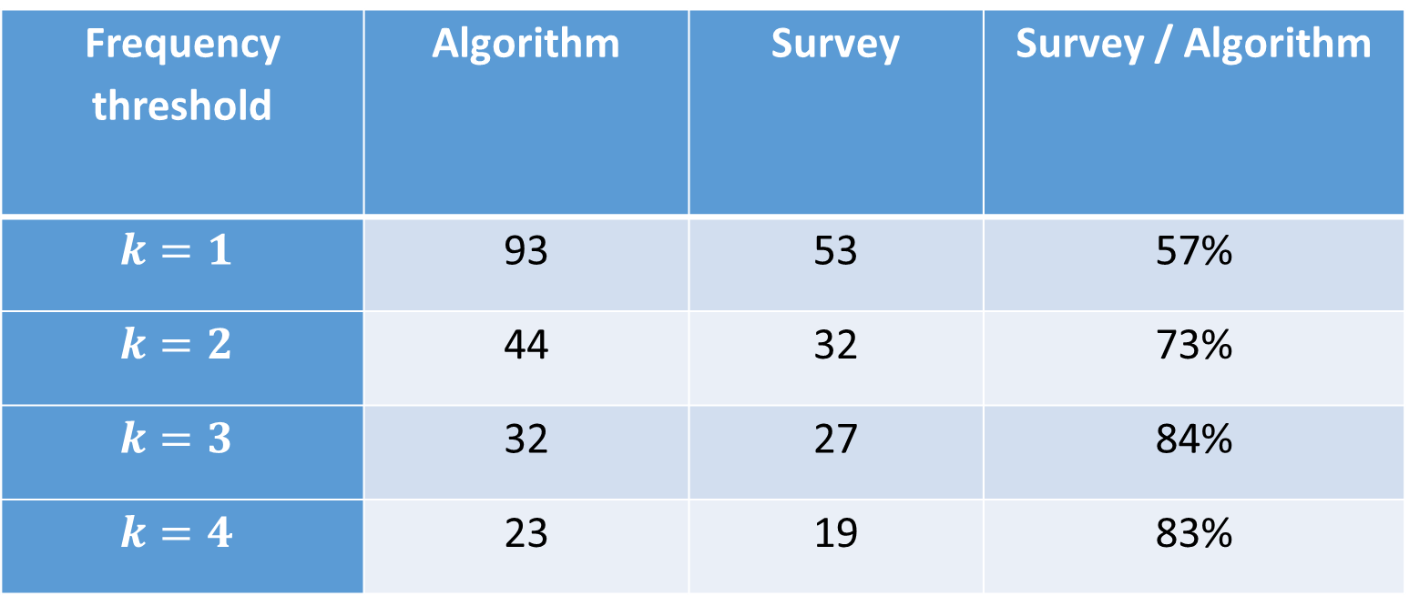
Percentage of pairs obtained via algorithm/survey
Frequency threshold | Algorithm | Survey | Survey / Algorithm
$$k=1$$ | 93 | 53 | 57%
$$k=2$$ | 44 | 32 | 73%
$$k=3$$ | 32 | 27 | 84%
$$k=4$$ | 23 | 19 | 83%

Slide 20
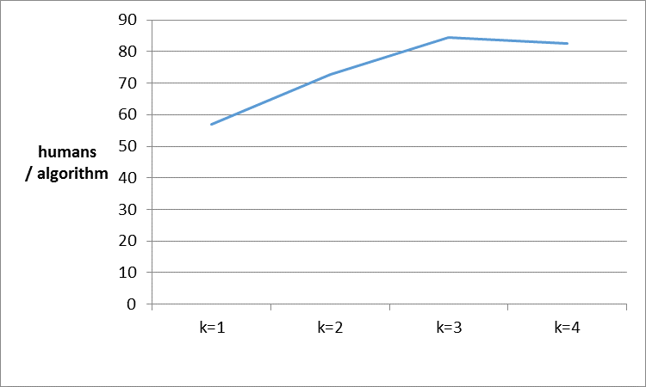
Manually/ automatically selected pairs with different frequency thresholds

Slide 21
Adj-N constructs as evaluated by online participants
5 out of 5 votes | 2 or less out of 5 votes
Tačan kao sat “Like clockwork” | Brz kao misao* “Quick as a thought”
Hladan kao led “Cold as ice” | Lak kao ptica* Frequency of occurrence in the Corpus k ≥ 4, but were not selected in the survey. “Light as a bird”
Hladan kao špricer “Cool as spritzer” | Beo kao kreda “White as chalk”
Tvrdoglav kao mazga “Stubborn as a mule” | Debeo kao bure “Fat as a barrel”
Lagan kao pero “Light as a feather” | Blistav kao zvezda “Shiny as a star”

Slide 22
Future work
Another survey with randomly chosen pairs
Advertised through the FB page of the Society for Language Resources and Technology as well as like before – less participants but more reliable ones – „Friendsourcing“

Slide 23
Thank you for your attention!

